Slide 1


The Drake Escape
Group 11

Slide 2



The Drake Escape
Group Members:
Rachelle Rogers
Justin Tran
Rambo Wu

Slide 3



The Drake Escape
Application Description:
-Drake and hip-hop educational game
-User plays as Drake to battle his enemies, paparazzi and mean tweets
–Multiple choice trivia questions helps boost the user’s score
Notes:
Our app is made to educate users about Drake, his history, and the hip-hop genre within an interactive game.
The user plays the game as Drake and answers various trivia questions regarding him.
The game also features the character fighting off the paparazzi and mean tweets.
A powerup will appear within the game will bring up a quizzing screen that will ask a multiple choice question.
Answering correctly will result in earning more points. Answering incorrectly will have no consequence.
The goal of the game is to survive through as many levels as possible and rack up a high score.
The levels will become progressively more difficult as the game go on.

Slide 4


The Drake Escape
Target Audience:
-Those interested in hip-hop culture and/or Drake fans
-The simplicity of the game allows users of all ages to play
-Audience can either learn or prove their current Drake and hip-hop knowledge
Notes:
The target audience is those interested in hip-hop or Drake fans.
Also those who would either like to learn more about that or prove their current knowledge.
Many hip-hop fans are very passionate and would enjoy playing this game as Drake.
Trivia questions along with a user driven game can be very fun and educational at the same time.
The ease of the game and variety of options makes this game addicting and allows a variety of users to play.

Slide 5


The Drake Escape
DEMO!

Slide 6


The Drake Escape
Application Functionality:
Hold touch left or right of Drake to move in that particular direction
Tap screen again while moving to jump (can double jump)
Tap anywhere on the bottom of the screen to shoot a projectile.
You only have one projectile, so you must pick it up to use it again.
Avoid touching randomly spawning paparazzi or mean tweets, doing so will make you lose a life

Slide 7

The Drake Escape
Application Challenges Experienced:
Learning how movement/animation works with designing graphics
Micro-managing all of the SpriteKitNode’s interactions with each other
Setting up and designing the database

Slide 8
The Drake Escape
Group Member Contributions:
Rachelle Rogers
Designed each screen’s view and the UI aspect of the game
Developed graphics, moveable characters, and reskins
Justin Tran
Developed the game world and functionality
Implemented physics, projectiles, movement, enemies, and character behaviors
Rambo Wu
Created functioning login screen, registration screen, and added trivia
Linked app to Firebase database and added minigames/trivia

Slide 9

The Drake Escape

Slide 10

The Drake Escape

Slide 11
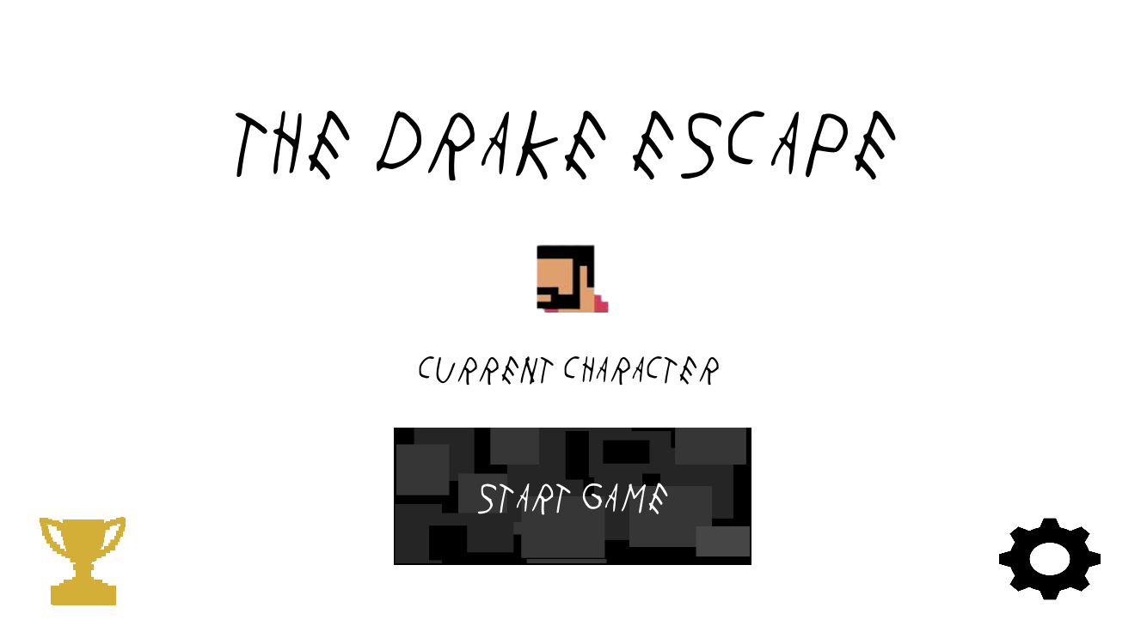
The Drake Escape

Slide 12
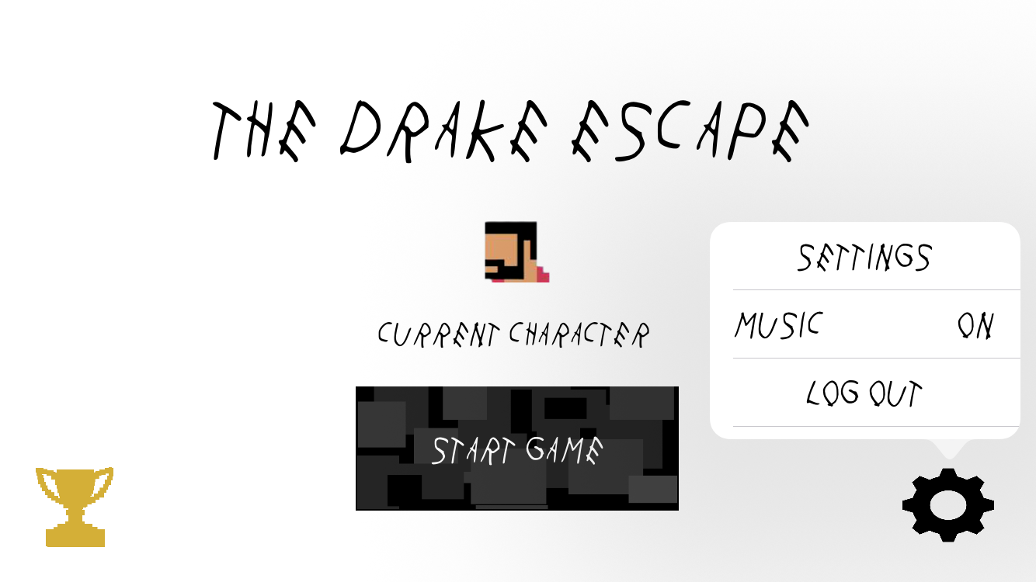
The Drake Escape

Slide 13
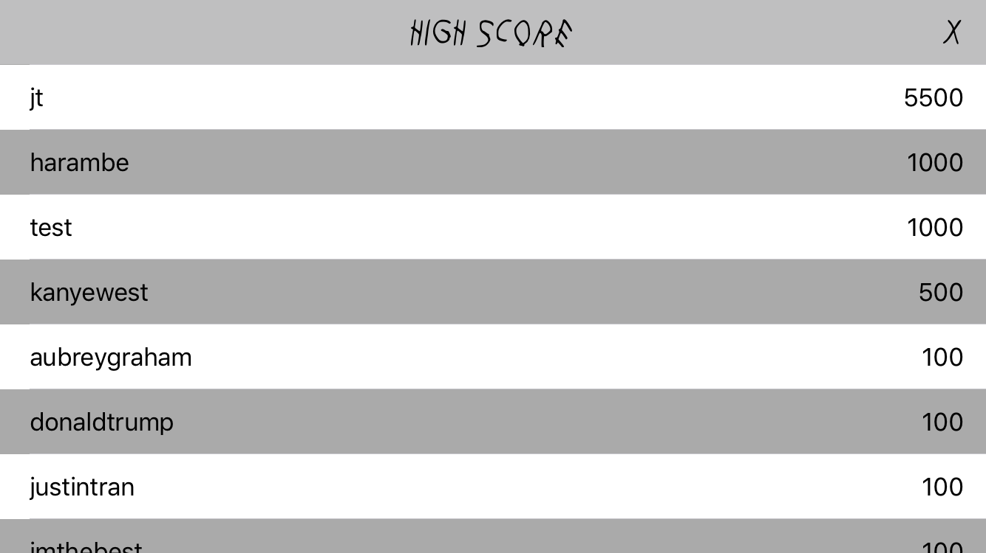
The Drake Escape

Slide 14
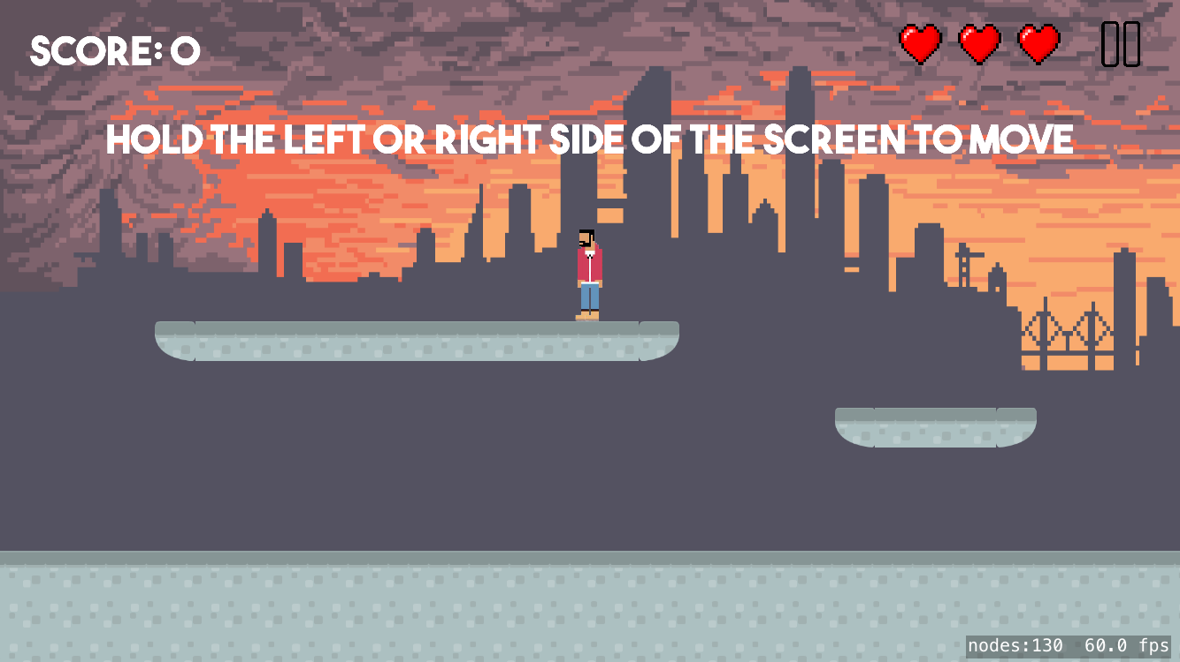
The Drake Escape

Slide 15
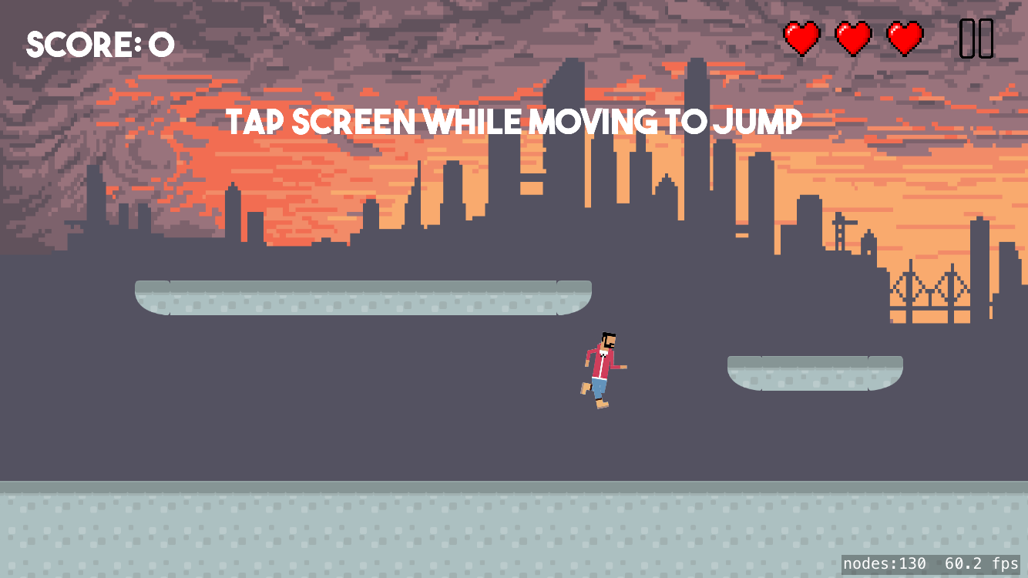
The Drake Escape

Slide 16
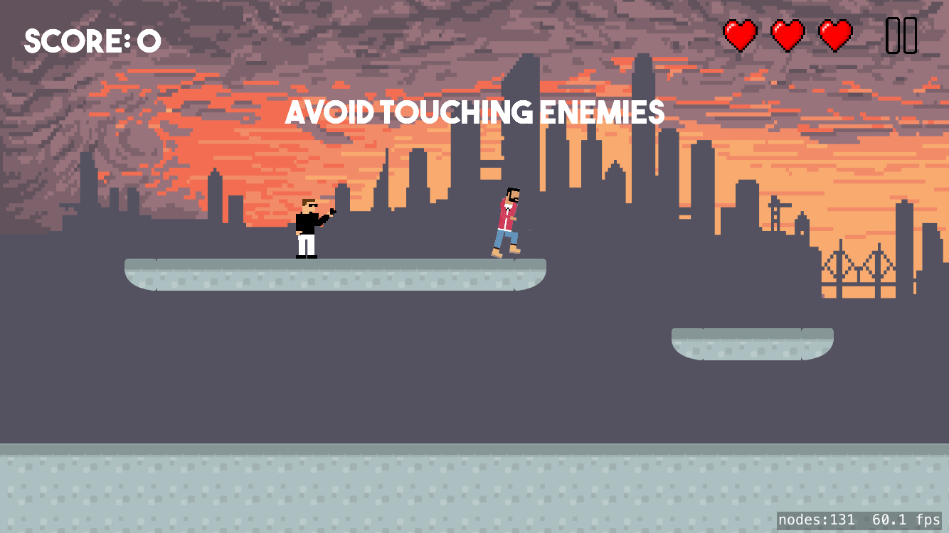
The Drake Escape

Slide 17
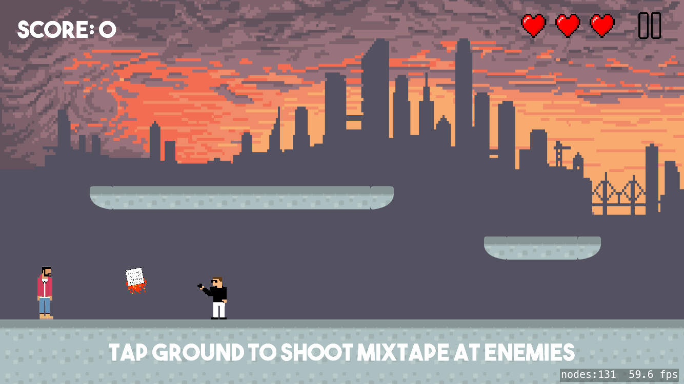
The Drake Escape

Slide 18
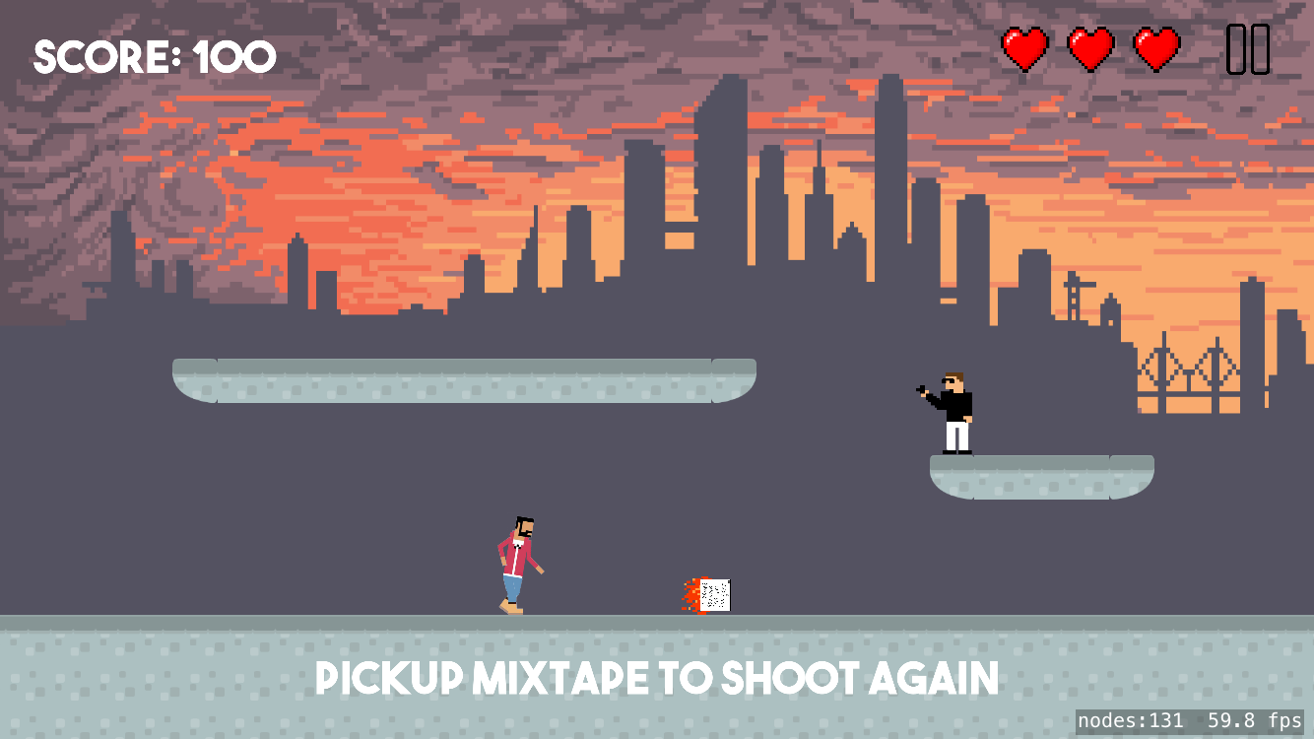
The Drake Escape

Slide 19
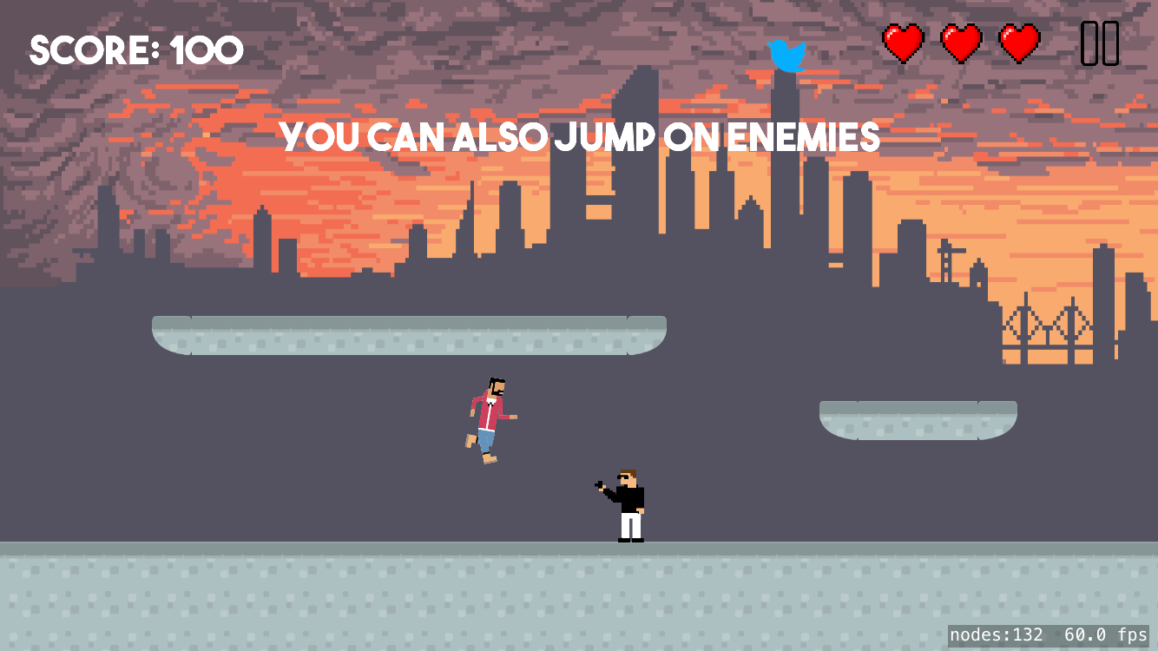
The Drake Escape

Slide 20
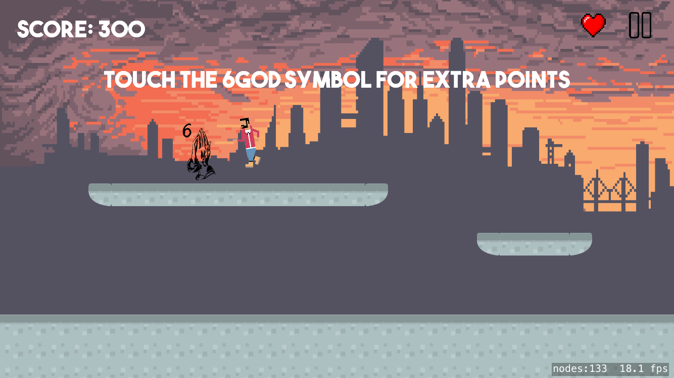
The Drake Escape

Slide 21
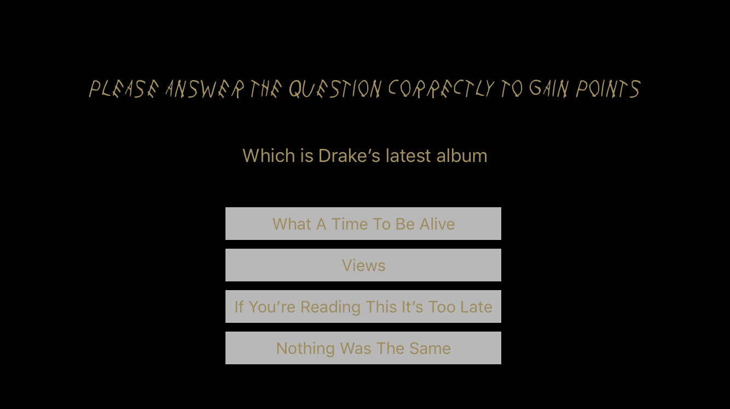
The Drake Escape

Slide 22

The Drake Escape

Slide 23

The Drake Escape
Q&A

